Slide 1

BASKETBALL
SHOT CLOCK
TRAINING
Notes:
The following presentation is information provided by the Oregon School Activities Association to shot clock operators, head boys’ and girls’ varsity and assistant varsity coaches, and varsity basketball officials for the 2023-2024 basketball season

Slide 2
Procedures (1/3)
35 second shot clock to be used for all OSAA varsity contests.
Use of the shot clock for the entire game, including overtime periods, except when there is less time remaining on the game clock than on the shot clock, then turn shot clock off.
The shot clock will continue to be used when 35 point score differential protocols are in place.
An alternate time device (a stop watch) is required at the scorer’s table should the shot clock fail.
Notes:
The 35 second shot clock to be used for all OSAA varsity contests.
The use of the shot clock for the entire game, including overtime periods, except when there is less time remaining on the game clock than on the shot clock, then turn shot clock off.
The shot clock will continue to be used when 35 point score differential protocols are in place.
An alternate time device (a stop watch) is required at the scorer’s table should the shot clock fail.

Slide 3
Procedures (2/3)
The shot clock does not stop play unless recognized by an official’s whistle, EVEN IF THE HORN SOUNDS.
Allow the game official to make the final decision when there is doubt as to whether the score was made within the shot clock time period or whether a try for goal contacted the rim or flange.
Notes:
The shot clock does not stop play unless recognized by an official’s whistle, EVEN IF THE HORN SOUNDS.
Allow the game official to make the final decision when there is doubt as to whether the score was made within the shot clock time period or whether a try for goal contacted the rim or flange.

Slide 4
Procedures (3/3)
When an obvious mistake by the shot clock operator has occurred in failing to set or reset the shot clock, the mistake may be corrected in the shot clock period in which it occurred only when the referee has definite information relative to the mistake and time involved.
Notes:
When an obvious mistake by the shot clock operator has occurred in failing to set or reset the shot clock, the mistake may be corrected in the shot clock period in which it occurred only when the referee has definite information relative to the mistake and time involved.

Slide 5
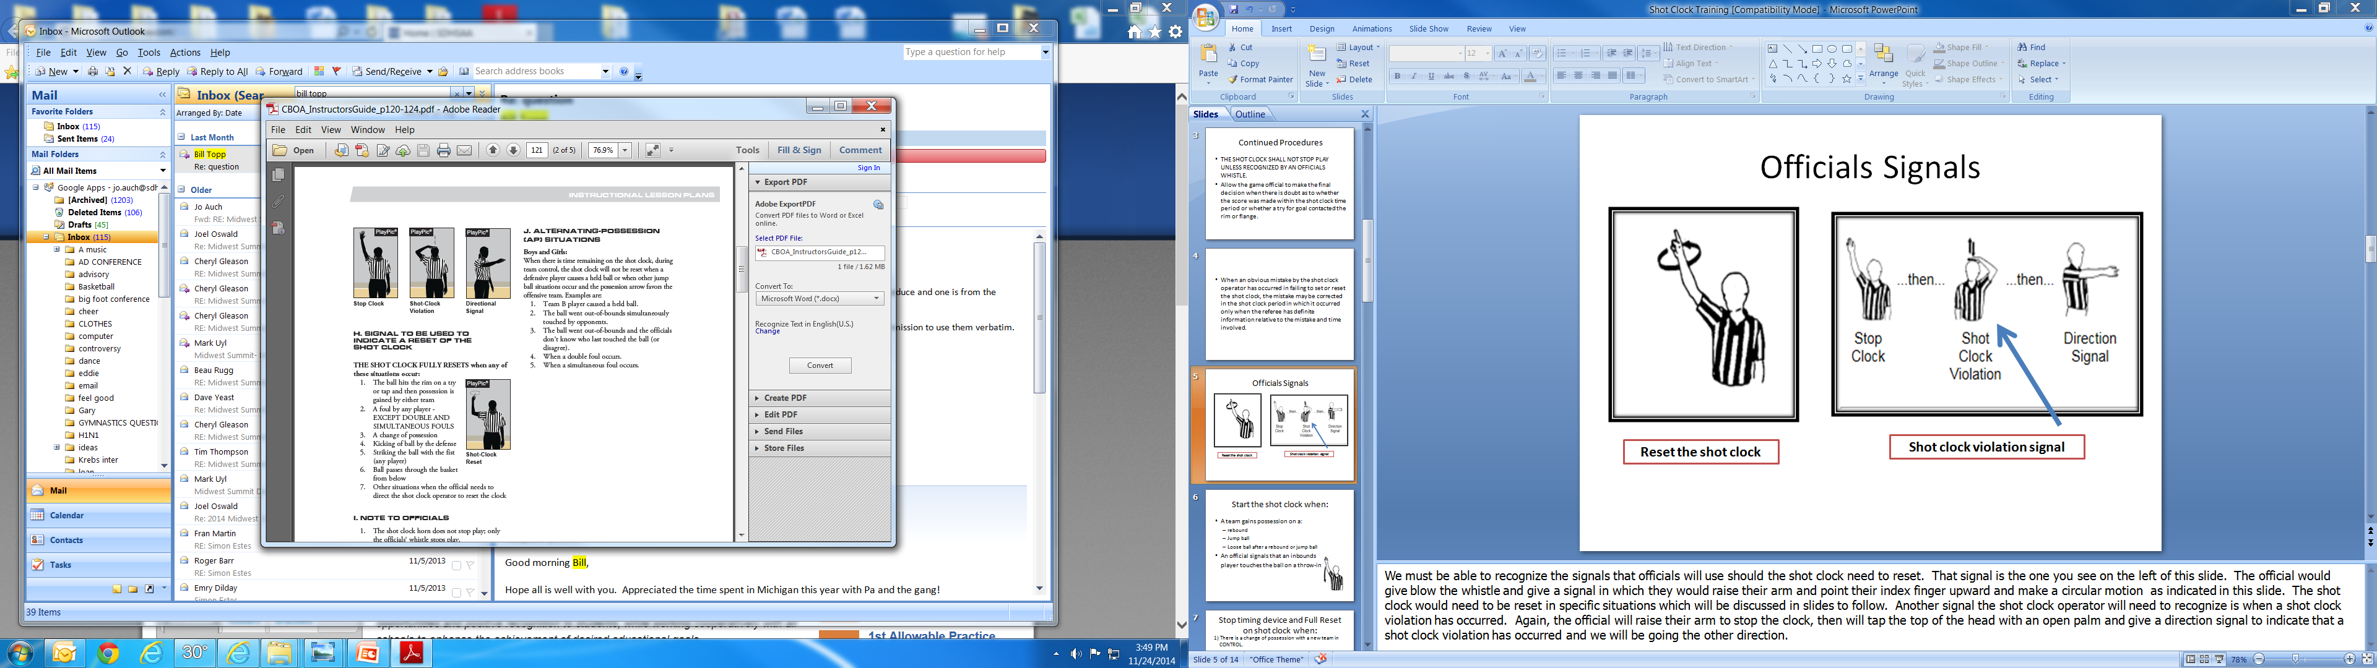
OFFICIALS SIGNALS
Play A
Play B
Notes:
The following signals are to be used for communication with the shot clock:
(Play Pic A) SHOT CLOCK RESET: The use of the index finger raised above the head in a circular motion 2-3 times. Generally to be used if an offensive rebound has been secured in which the ball touched the rim or flange.
If there is a shot clock violation, the following three signals should be used in order:
(Play Pic B) STOP CLOCK: Whistle is blown and arm is extended above the head to indicate the clock should be stopped.
SHOT CLOCK VIOLATION: One hand placed on top of the head and moved up and down 2-3 times.
DIRECTIONAL SIGNAL: Simply point with one arm the direction of the team receiving the ball is to go.

Slide 6

START THE SHOT CLOCK WHEN
A team gains possession on a:
- Rebound
- Jump ball
- Loose ball after a rebound or jump ball
An official signals that an inbounds player touches the ball on a throw-in.
Notes:
The shot clock operator will need to understand when to start the shot clock. The shot clock operator needs to start the clock when a team gains possession on a rebound, a jump ball or when a team gains possession on a loose ball after a rebound or jump ball. The shot clock operator also will start the shot clock when an official gives the start the clock signal when the official drops the arm down when an inbound players touches the ball on a throw-in.

Slide 7
ALLOW THE SHOT CLOCK TO RUN
During loose ball situations.
During a try for goal.
When a try for a goal is attempted… be patient to reset.
When a field goal is attempted at the wrong basket.
During a loose ball when the OFFENSE maintains possession.
TURN OFF shot clock when there is reset situation and there is less than 35 seconds remaining on the game clock.
Notes:
Shot clock operators should allow the shot clock to run during loose ball situations and during a try for a goal. Be patient to reset the clock.
Shot clock operators should turn off the shot clock where there is a reset situation and there is less than 35 seconds remaining on the game clock.

Slide 8
ALLOW THE SHOT CLOCK TO CONTINUE TO RUN
The defensive team touches the ball but does NOT gain CONTROL.
A blocked try/tap is recovered by the OFFENSIVE team.
A try/tap FAILS to hit the rim or flange and is recovered by the OFFENSIVE team.
A try for a goal is attempted… be patient to reset.
A field goal is attempted at the wrong basket.
During a loose ball and the OFFENSE maintains possession.
Notes:
So here is a quick review that will help in critical situations.
Allow the clock to continue to run when:
The defensive team touches the ball but does NOT gain CONTROL
A blocked try/tap is recovered by the OFFENSIVE team
a try/tap FAILS to hit ring and is recovered by OFFENSIVE team
A try for a goal is attempted …be patient to reset
A field goal is attempted at the wrong basket
During a loose ball the OFFENSE maintains possession.

Slide 9
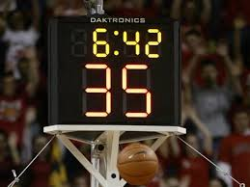
FULL RESET ON THE SHOT CLOCK WHEN (1/2)
There is a change of possession with a new team in CONTROL.
There is a single personal foul. (Play clock stops also)
There is a single technical foul on the defensive team. (Play clock stops also)
A try/tap for a goal hits the rim or flange then a team possesses the ball.
Notes:
The next two slides will tell use when we should utilize a full reset on the shot clock. The shot clock shall be fully reset when:
There is a change of possession with a new team in control
There is a single personal foul
There is a single technical foul on the defensive team
A try/shot hits the rim or flange then a team possesses the ball.

Slide 10
FULL RESET ON THE SHOT CLOCK WHEN (2/2)
There is an inadvertent whistle with no team control at the time of the whistle. (Play clock stops also)
If a held ball occurs and a change of team possession take place. (Play clock stops also)
If a try/tap FAILS to hit the rim and is recovered by the opponent.
Notes:
5) There is an inadvertent whistle with no team control at the time of the whistle.
6) If a held ball occurs and a change of team possession takes place.
7) If a try/tap FAILS to hit the rim and is recovered by the opponent.

Slide 11
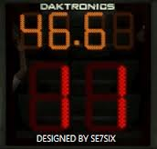
NO RESET ON THE SHOT CLOCK WHEN (1/2)
The offense retains possession after the following:
- a held ball.
- an out of bounds violation.
There is an injured player for either team.
There is a timeout called by either team, official, or media.
Notes:
The shot clock will not be reset when:
1) The offense retains possession after the following:
a held ball
An out-of-bounds violation
2) There is an injured player for either team.
3) There is a timeout called by either team, official or media.

Slide 12
NO RESET ON THE SHOT CLOCK WHEN (2/2)
A double foul occurs unless one of the fouls is a flagrant foul.
There is a technical foul on the offensive team.
There is an inadvertent whistle with team control.
Notes:
4)A double foul occurs unless one of the fouls is a flagrant foul.
5) There is technical foul on the offensive team.
6) There is an inadvertent whistle with team control.

Slide 13
CHEAT SHEET
Allow the shot clock to run when:
- the defensive team touches the ball but does NOT gain control.
- a blocked try/tap is recovered by the OFFENSIVE team.
- a try/tap fails to hit the rim or flange and is recovered by the OFFENSIVE team.
Notes:
Allow the shot clock to run when:
- When the defensive team touches the ball but does NOT gain control.
- When a blocked try/tap is recovered by the OFFENSIVE team.
- When a try/tap ails to hit a ring or flange and is recovered by the OFFENSIVE team.

Slide 14
ADDITIONAL THOUGHTS (1/2)
There is no visible 10 second count in the backcourt with a shot clock. If the shot clock is at 25 and the ball is in the backcourt, it is a violation.
If the shot clock gets to 30 seconds, the ball is still in the backcourt and Team A calls a timeout, there is still no visible 10 second count in the backcourt with a shot clock. If the shot clock is at 20 and the ball is in the backcourt, it is a violation.
Rule 9-10 ( Closely guarded) is to continue to be called while the ball is in the front court.
Notes:
There is no visible 10 second count in the backcourt with a shot clock. If the shot clock is at 25 and the ball is in the backcourt, it is a violation.
If the shot clock gets to 30 seconds, the ball is still in the backcourt and Team A calls a timeout, there is still no visible 10 second count in the backcourt with a shot clock. If the shot clock is at 20 and the ball is in the backcourt, it is a violation.
Rule 9-10 ( Closely guarded) is to continue to be called while the ball is in the front court.

Slide 15
ADDITIONAL THOUGHTS (2/2)
Keep in mind that the mere touching of the ball by an opponent does not start a new shot clock period when the SAME TEAM remains in control of the ball.
A late reset is better than an early reset- BE PATIENT.
When in doubt, DON’T reset.
Notes:
Be slow to reset the clock when there is a touch by the opponent. Keep in mind that the mere touching of the ball by an opponent does not start a new shot clock period when the SAME TEAM remains in control of the ball.

Slide 16
QUESTIONS?
Monica Maxwell
OSAA, Assistant Executive Director
monicam@osaa.org
503-682-6722 ext. 229
Cam Rust
State Rules Interpreter, Basketball
camrust@pboa.org
503-307-2016
Notes:
Should you have any questions concerning the content of this presentation, please feel free to contact one of the listed personnel for further information. Best of luck to all of you and thank you for your help as we transition into the shot clock for all varsity basketball contests for the OSAA.

